Slide 1

Project Update | Public Meeting
September 30, 2025

Slide 2
9/15 | Council Presentation
& Bidding
ODNR H2Ohio
$913,804
6/6 | 90% Design & Apply for USACE Permits
2022-2025
Design
Ohio CAP
$380,000
2019 2020 2021 2022 2023 2024 2025 2026 2027
1/1 | Rosemont Golf Course Closes
10/26 | Parks & Planning Commission
Presentation
OEPA 319
$302,475
2026-2027
Construction
3/17 | Rosemont Greens Development Planning Commission Presentation
DEFA WRRSP
$1,241,897
9/11 | Planning Commission Presentation
AGENDA
Project Goals
Final Design & Wayfinding
Bicentennial Park Integration
Funding & Financing
Schedule & Construction

Slide 3
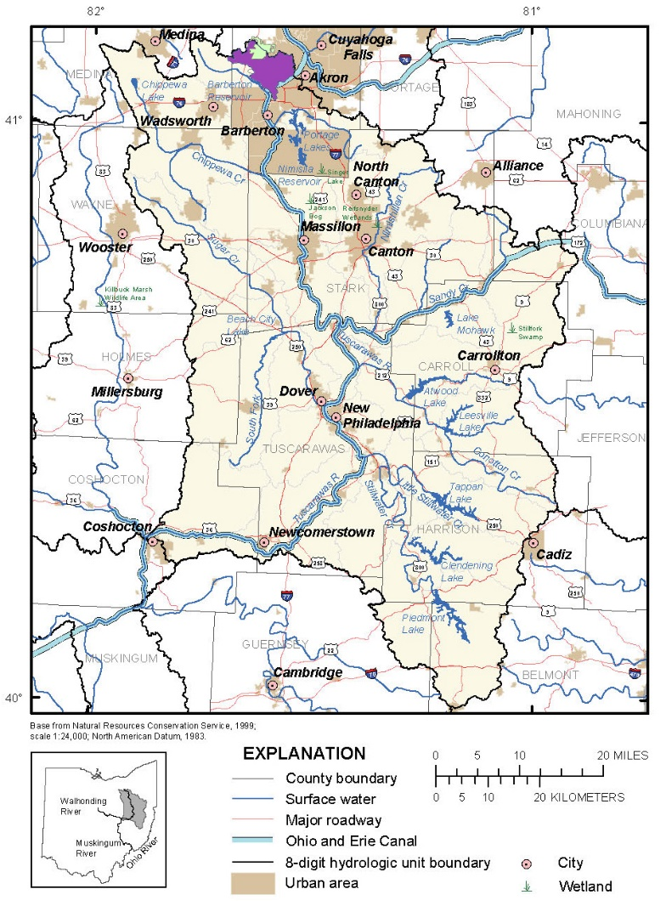
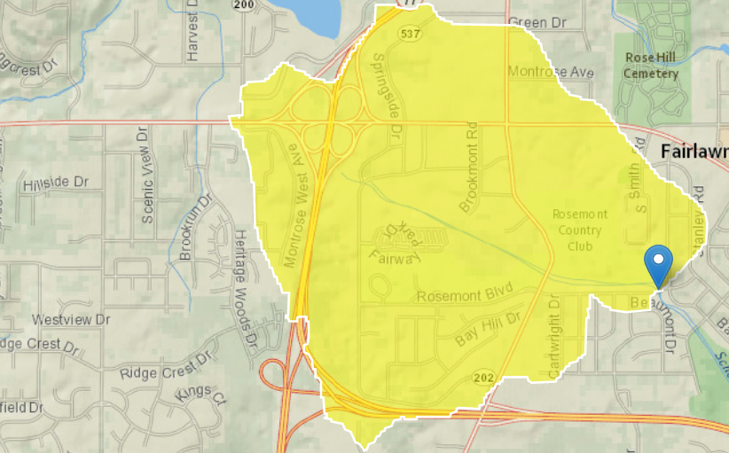
PROJECT GOALS
  Flood Control
  Aquatic Enhancements
  Vegetative Improvements
  Landform Amenities

Slide 4
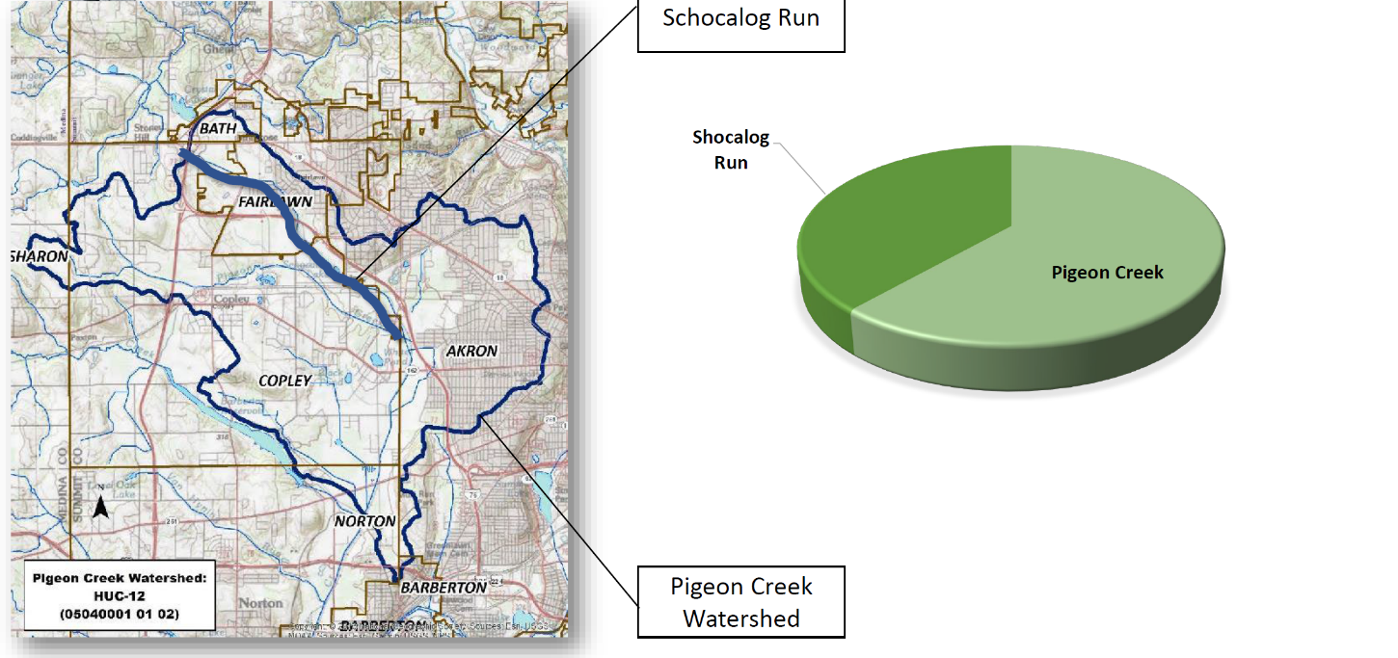
PROJECT GOALS
  Flood Control
  Aquatic Enhancements
  Vegetative Improvements
  Landform Amenities
Notes:
Schocalog Run is almost ½ of the Pigeon Creek watershed, which runs through

Slide 5
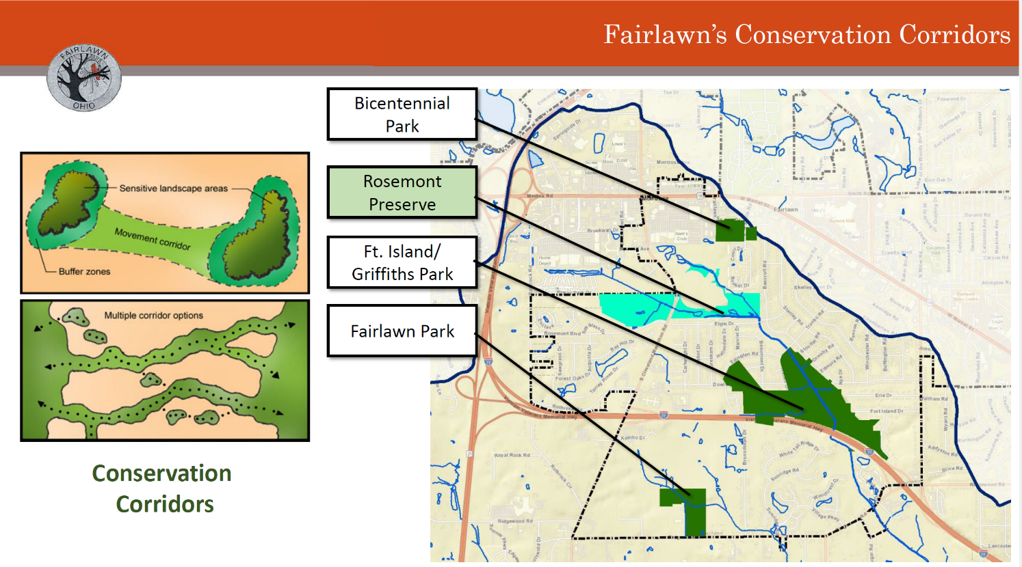
PROJECT GOALS
  Flood Control
  Aquatic Enhancements
  Vegetative Improvements
  Landform Amenities
Notes:
We spoke about how this is an important conservation corridor in Fairlawn.

Slide 6
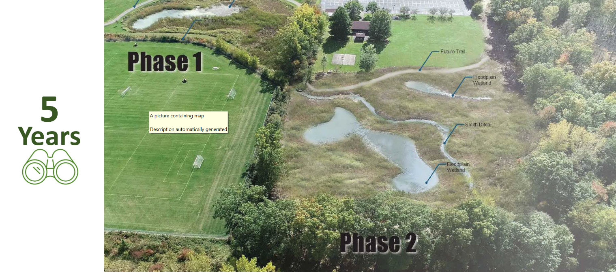
PROJECT GOALS
  Flood Control
  Aquatic Enhancements
  Vegetative Improvements
  Landform Amenities
Notes:
How it builds upon the Glacier’s Edge Greenway, which just completed restoration project #4.

Slide 7
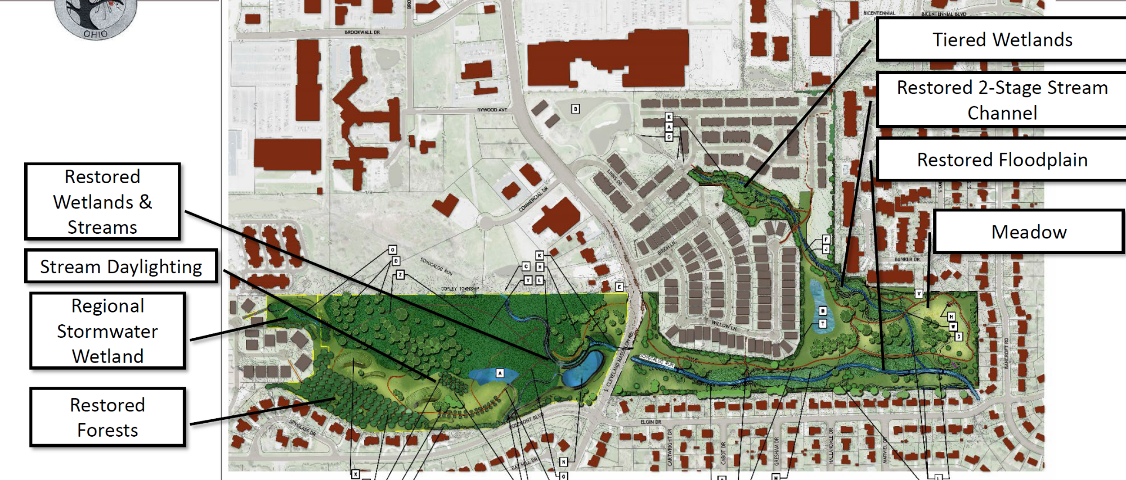
Notes:
In 2022, we performed a master plan with restoration, trails, regional stormwater flood control and restored forests.

Slide 8
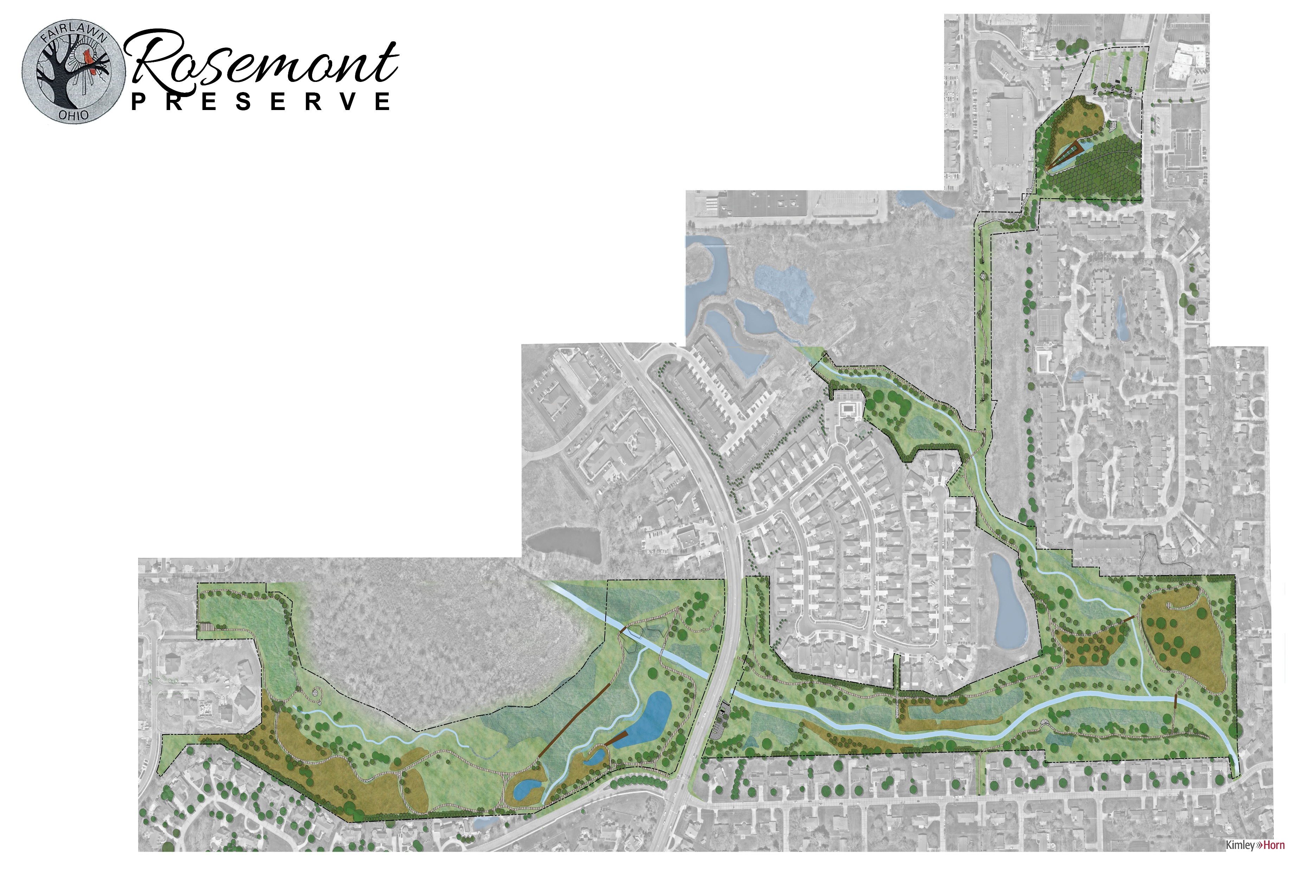

PROJECT GOALS
  Flood Control
  Aquatic Enhancements
  Vegetative Improvements
  Landform Amenities
Restored Wetlands and Streams
Tiered Wetlands
Regional Stormwater Wetland
Restored 2-Stage Stream Channel
Restored Forests
Meadow
Stream Daylighting
Restored Floodplain
Notes:
Today, we’re here to update you on the final plans and discuss with you the project details as it heads out to bid and construction.
Not only does our plan include everything we promised in our master plan from 2022, we included so much more. We’re going to discuss how the final design relates to each of the 4 project goals.

Slide 9

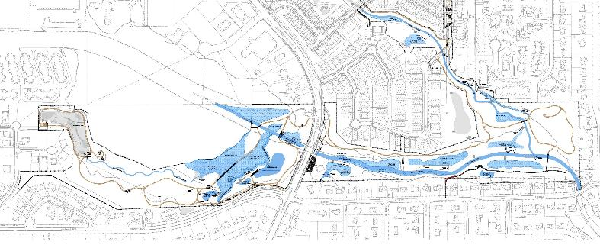
GOAL
Counteract increase flow from stopping water reuse irrigating golf course from 5 irrigation ponds/impoundments
Reduce yard flooding at homes on Elgin, which occurred during 2-year storms
Reduce garage flooding in Westwood
Slow flow at Ft. Island/Griffith Park to reduce erosion
FLOOD CONTROL
Added 8.6 ac-ft of flood storage
Creation of multiple oxbow wetlands
These activate at the 2-year storm event and above storms
Inline storage
Offline storage
DESIGN
Notes:
Offline storage provide flood control for storm sewers coming into the site from developments. Offline has more control during lower flow storms, which have a greater impact to counteracting the removal of the irrigation ponds.
Over 2.4 million gallons of stormwater being controlled by this project. This project is cheaper than a gallon of milk - $2.79/gallon/year.

Slide 10
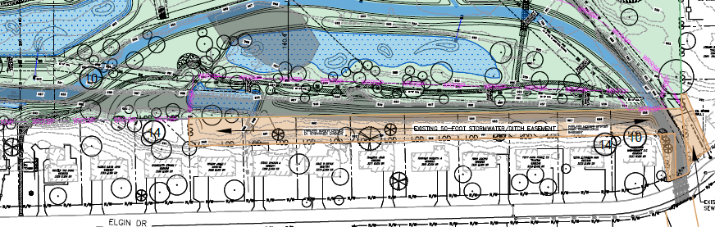
GOAL
Counteract increase flow from stopping water reuse irrigating golf course from 5 irrigation ponds/impoundments
Reduce yard flooding at homes on Elgin, which occurred during 2-year storms
Reduce garage flooding in Westwood
Slow flow at Ft. Island/Griffith Park to reduce erosion
FLOOD CONTROL
Move Schocalog Run 50-feet away from homes on Elgin
Proposed Schocalog Run (blue)
Existing Schocalog Run (gray)
DESIGN
Notes:
Moved Schocalog Run away from the backyards that were flooding. This also aligned the creek with the 4 culverts under Elgin, which will reduce erosion around the culverts and assist with elongating the lifespan of these culverts

Slide 11
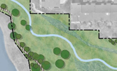
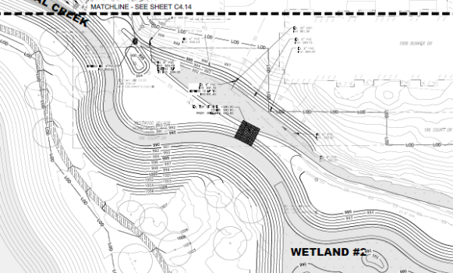
GOAL
Counteract increase flow from stopping water reuse irrigating golf course from 5 irrigation ponds/impoundments
Reduce yard flooding at homes on Elgin, which occurred during 2-year storms
Reduce garage flooding in Westwood
Slow flow at Ft. Island/Griffith Park to reduce erosion
FLOOD CONTROL
Removed dams and in-stream structures that were blocking stormwater from the Westwood storm pipes from discharging during storms
DESIGN
Notes:
There are 9 separate storm sewer lines that discharge to this creek. The in-line irrigation ponds structures previously wouldn’t allow for the conveyance of stormwater through the site to the stream. It would back up

Slide 12
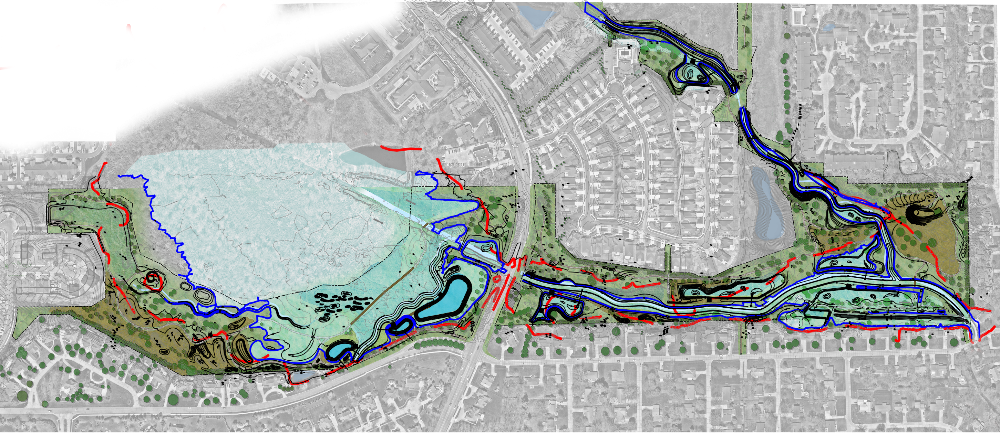
GOAL
Counteract increase flow from stopping water reuse irrigating golf course from 4 irrigation ponds/impoundments
Reduce yard flooding at homes on Elgin, which occurred during 2-year storms
Reduce garage flooding in Westwood
Slow flow at Ft. Island/Griffith Park to reduce erosion
FLOOD CONTROL
Existing 100-Year Flood Elev (red)
Proposed 100-Year Flood Elev (blue)
Cleveland Massillon Road
Elgin Road
DESIGN
Notes:
8.6 ac-ft of additional storage
Decreases the Peak 100 HGL on Schocalog
West: reduction of ~ 2.53 feet at Cleveland-Massillon Culvert
East: reduction of 2 feet at Elgin

Slide 13
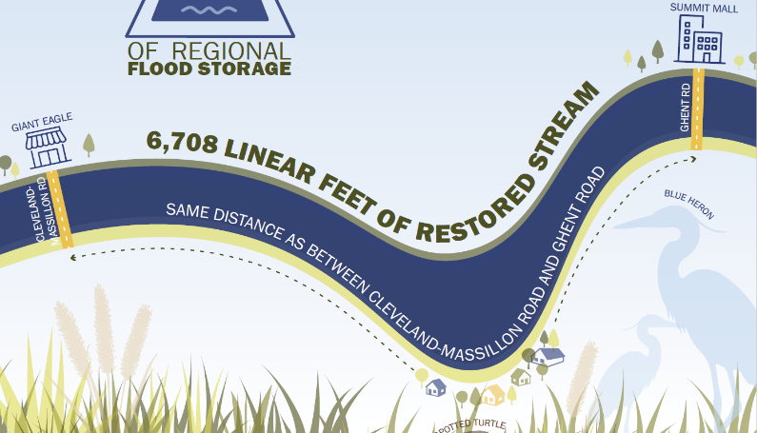
GOAL
Recover fish passage
Develop in-stream habitat
Improve water quality for the watershed (NPS-IS goals)
AQUATIC ENHANCEMENTS
ADDED SINUOSITY
Shocalog Run (East) – 2,528 lf restored creek (was 1,750 lf)
Schocalog Run (West) – 837 lf still ditch, but added floodplain
Spyglass Creek – 1,100 lf daylighted creek (was 0 lf)
Westchester Creek – 883 lf restored creek (was 600 lf)
Bicentennial Creek – 2,196 linear feet (was 0 lf)
DESIGN

Slide 14
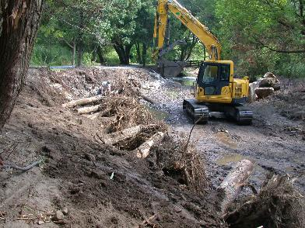
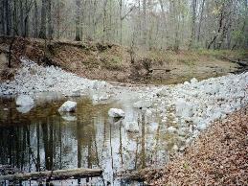
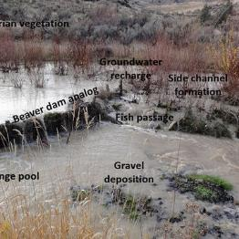
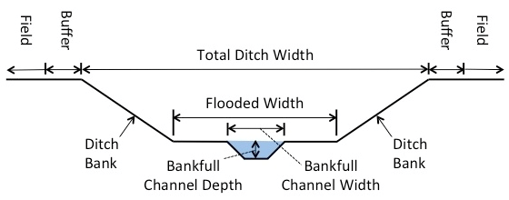
GOAL
Recover fish passage
Develop in-stream habitat
Improve water quality for the watershed (NPS-IS goals)
AQUATIC ENHANCEMENTS
In-stream woody debris
  Beaver Analogs – Spyglass Creek
  Toe wood – Schocalog Run East
In-stream riffles
  Bicentennial Creek
  Schocalog Run east side
DESIGN

Slide 15
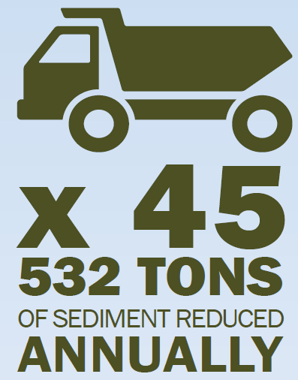
GOAL
Recover fish passage
Develop in-stream habitat
Improve water quality for the watershed (NPS-IS goals)
AQUATIC ENHANCEMENTS
    Stormwater Wetlands
      Cartwright Drive Watershed : 23.25 acres drainage area
      Marviel Drive Watershed: 40.76 acres drainage area
    In-wetland woody debris
  Kettle Lakes Design Strategies
    Disconnect Rosemont Drive storm sewers
    Utilize lakes for stormwater treatment
  Using the USEPA’s PLET tool, pollutant reductions are estimated at:
    - 24% for nitrogen (979 lbs/year)
    -24% phosphorus (377 lbs/year)
    -17% BOD (dissolved oxygen) – great for fish
    -50% reduction (532 tons of sediment annually—the equivalent of 45 full dump trucks).
DESIGN

Slide 16
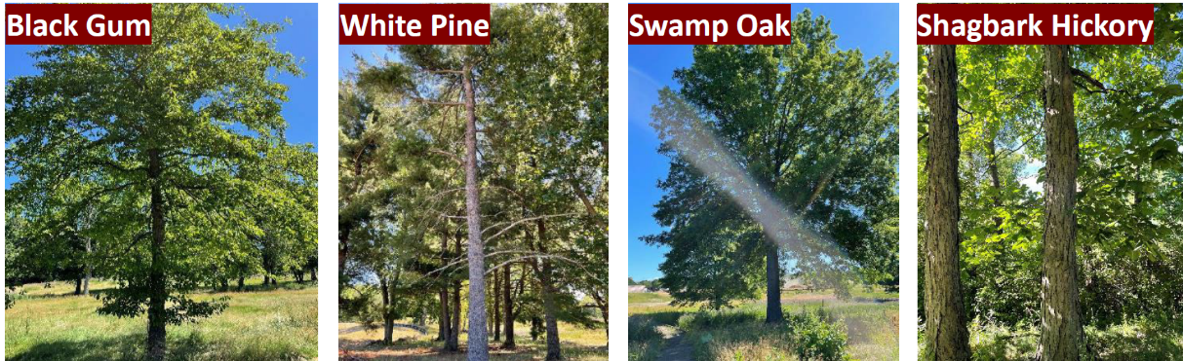
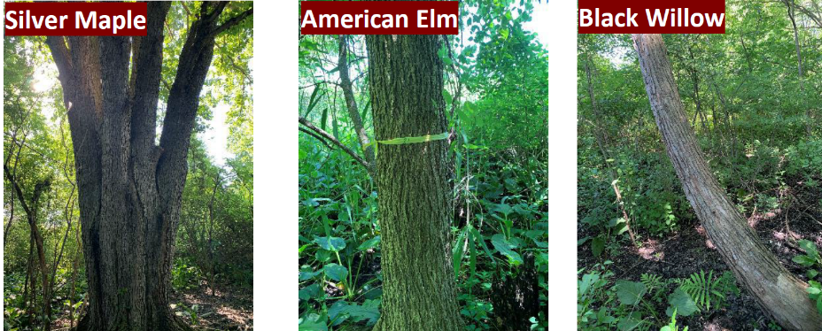
GOAL
Reduce/Control invasive species
Retain existing healthy trees
Vegetative buffer around residential properties
Upland meadows for habitat
Diversity of vegetation habitats
VEGETATIVE IMPROVEMENTS
  Bats:
  Little brown bat (Myotis lucifugus)
  Indiana bat (Myotis sodalis)
  Northern long-eared bat (Myotis septentrionalis)
  Little brown bat (Myotis lucifugus)
  Tricolored bat (Perimyotis subflavus)
  Fish:
  Iowa darter (Etheostoma exile)
  Pugnose minnow (Opsopoeodus emiliae)
  Western banded killifish (Fundulus diaphanus menona)
  Lake chubsucker (Erimyzon sucetta)
  Paddlefish (Polyodon spathula)
  Reptiles:
  Smooth greensnake (Opheodrys vernalis)
  Spotted turtle (Clemmys guttata)
  Birds:
  American bittern (Botaurus lentiginosus)
  Black tern (Chlidonias niger)
  King rail (Rallus elegans)
  Least bittern (Ixobrychus exilis)
  Northern harrier (Circus hudsonis)
  Sandhill crane (Grus canadensis)
  Upland sandpiper (Bartramia longicauda)
DESIGN

Slide 17
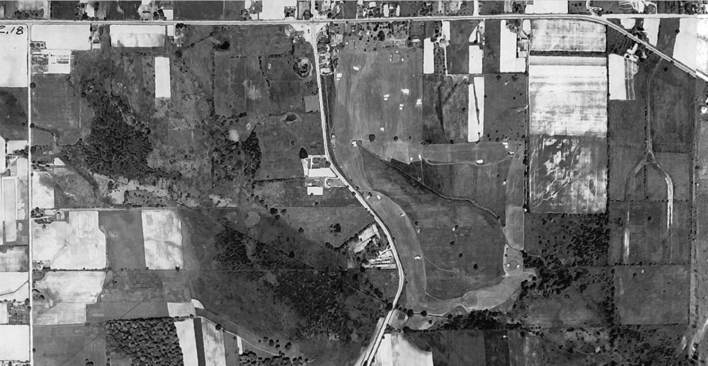
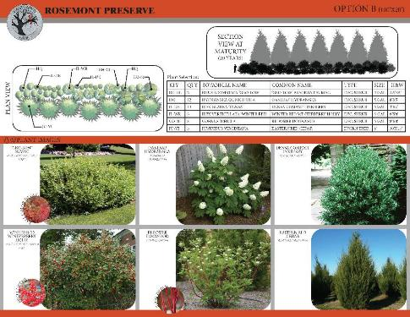
GOAL
Reduce/Control invasive species
Retain existing healthy trees
Vegetative buffer around residential properties
Upland meadows for habitat
Diversity of vegetation habitats
VEGETATIVE IMPROVEMENTS
Figure 1: 1937 Aerial Image with Rosemont Preserve outlined in yellow
DESIGN

Slide 18
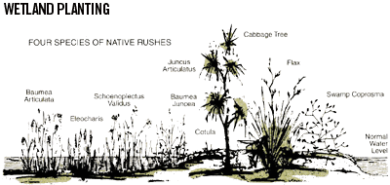
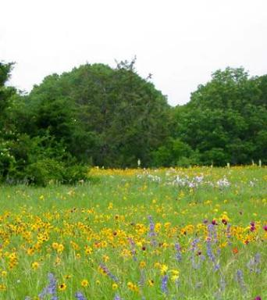
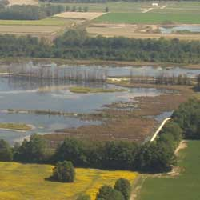
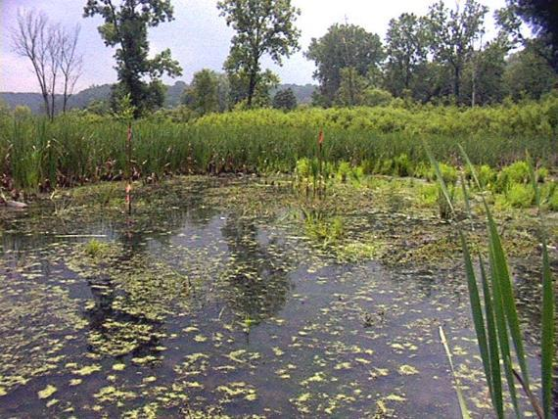
GOAL
Reduce/Control invasive species
Retain existing healthy trees
Vegetative buffer around residential properties
Upland meadows for habitat
Diversity of vegetation habitats
VEGETATIVE IMPROVEMENTS
DESIGN

Slide 19
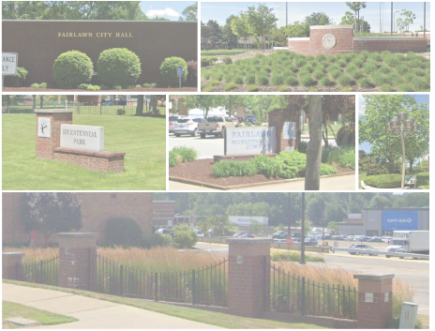
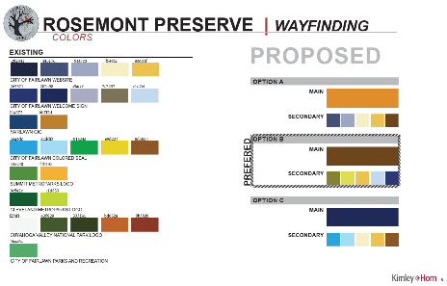
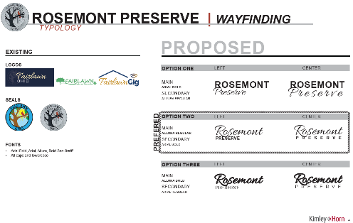
GOAL
Integrate Fairlawn character into the site
Integrate the region and site’s history– glaciers, golf, natural resources
Regionally significant and distinct passive recreation
Strengthen regional trail & waterway connections
Add ecotourism opportunities
LANDFORM AMENITIES
Wayfinding Plan
DESIGN
Notes:
We wanted to integrate the feeling of Fairlawn throughout the Prese4rve, that meant review the existing conditions, colors, architectural styles and materials around the city.

Slide 20
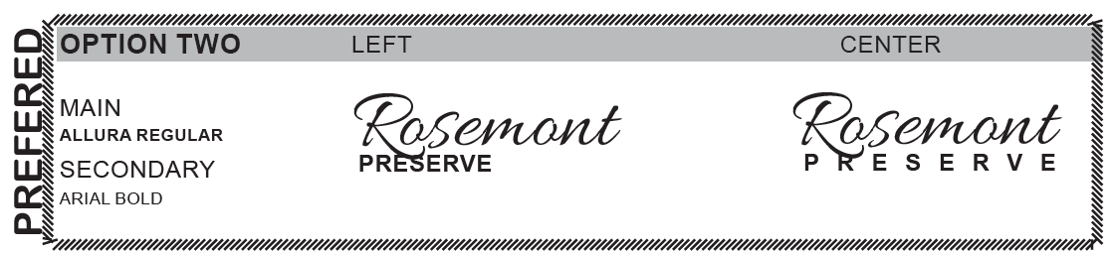

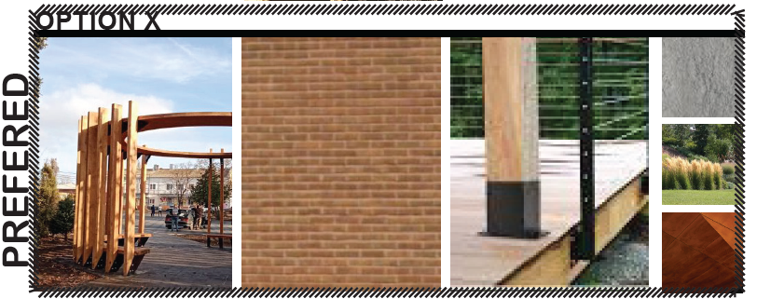
GOAL
Integrate Fairlawn character into the site
Integrate the region and site’s history– glaciers, golf, natural resources
Regionally significant and distinct passive recreation
Strengthen regional trail & waterway connections
Add ecotourism opportunities
LANDFORM AMENITIES
Wayfinding Plan
DESIGN
Notes:
We wanted to integrate the feeling of Fairlawn throughout the Prese4rve, that meant review the existing conditions, colors, architectural styles and materials around the city.

Slide 21
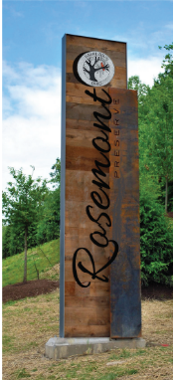
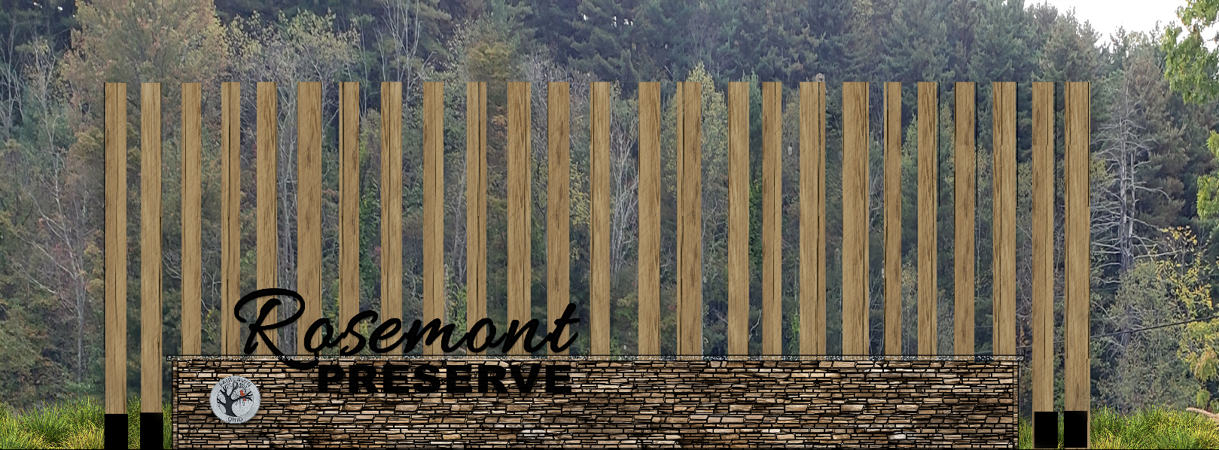
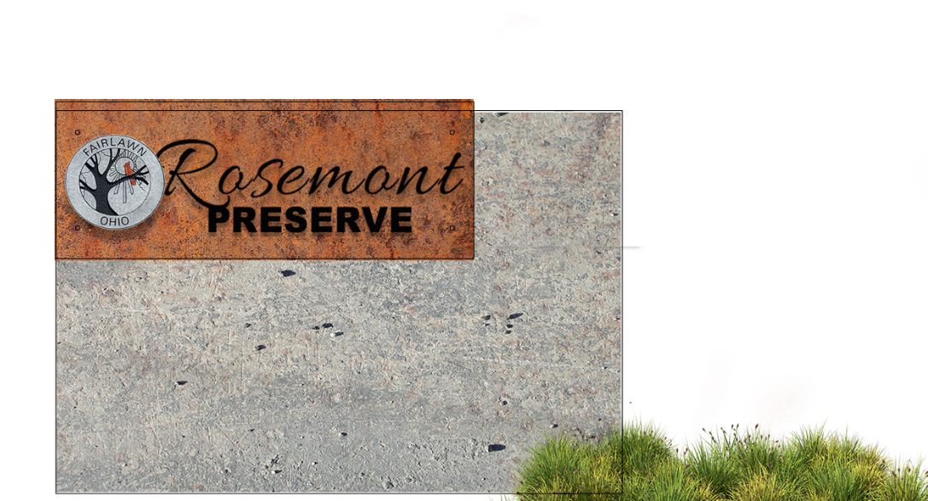
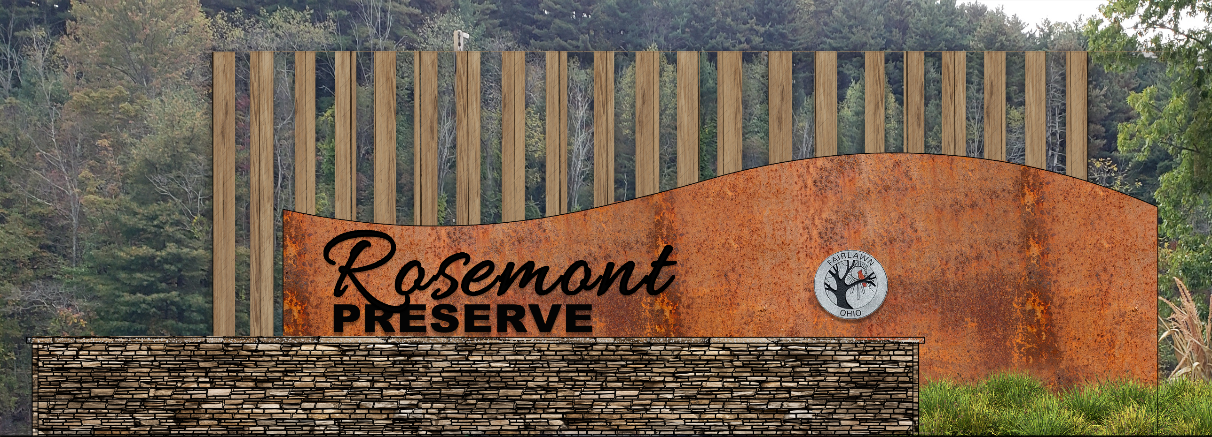
GOAL
Integrate Fairlawn character into the site
Integrate the region and site’s history– glaciers, golf, natural resources
Regionally significant and distinct passive recreation
Strengthen regional trail & waterway connections
Add ecotourism opportunities
LANDFORM AMENITIES
Wayfinding Plan
DESIGN
Notes:
We wanted to integrate the feeling of Fairlawn throughout the Prese4rve, that meant review the existing conditions, colors, architectural styles and materials around the city.

Slide 22
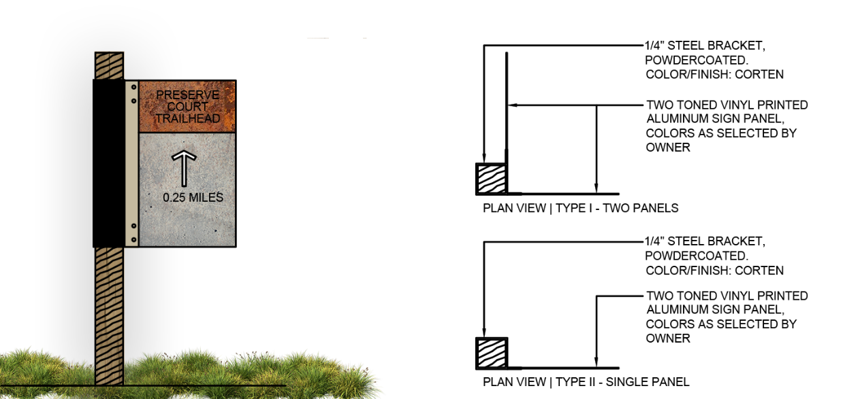
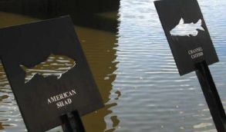
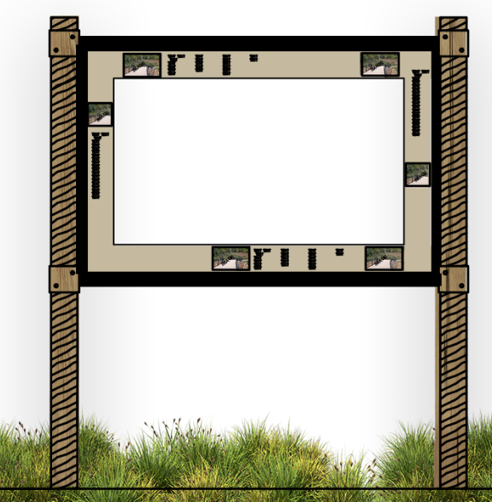
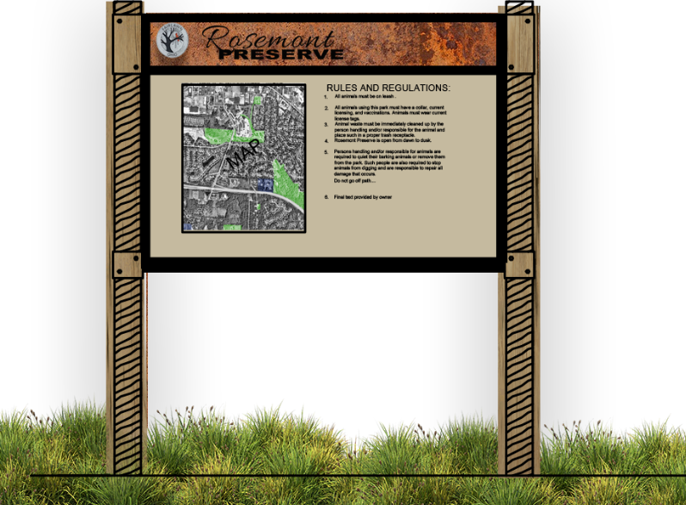
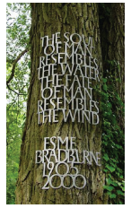
GOAL
Integrate Fairlawn character into the site
Integrate the region and site’s history– glaciers, golf, natural resources
Regionally significant and distinct passive recreation
Strengthen regional trail & waterway connections
Add ecotourism opportunities
LANDFORM AMENITIES
Wayfinding Plan
DESIGN
Notes:
We wanted to integrate the feeling of Fairlawn throughout the Prese4rve, that meant review the existing conditions, colors, architectural styles and materials around the city.

Slide 23
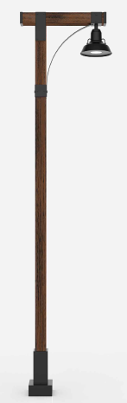

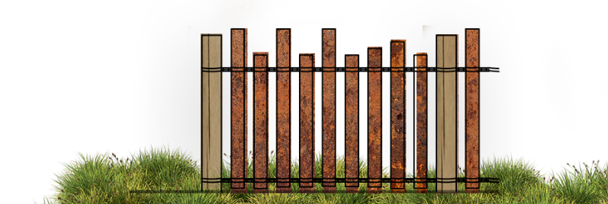
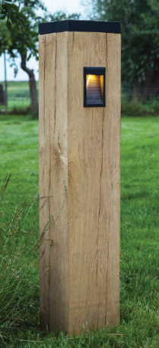
GOAL
Integrate Fairlawn character into the site
Integrate the region and site’s history– glaciers, golf, natural resources
Regionally significant and distinct passive recreation
Strengthen regional trail & waterway connections
Add ecotourism opportunities
LANDFORM AMENITIES
Lighting & Decorative Fencing
DESIGN

Slide 24
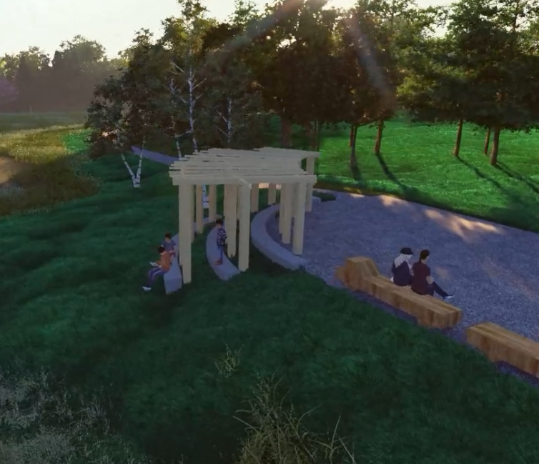
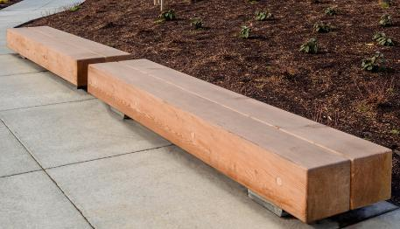
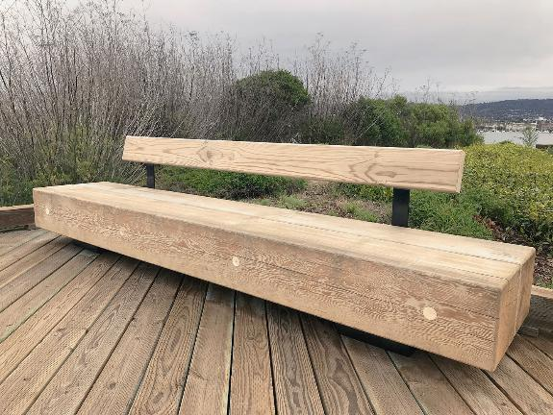
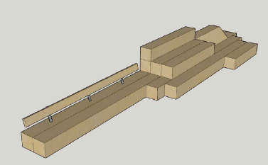
GOAL
Integrate Fairlawn character into the site
Integrate the region and site’s history– glaciers, golf, natural resources
Regionally significant and distinct passive recreation
Strengthen regional trail & waterway connections
Add ecotourism opportunities
LANDFORM AMENITIES
Bird blinds/wildlife viewing
Integration with revitalized Bicentennial Park
Benches
DESIGN
Trellis overlook

Slide 25
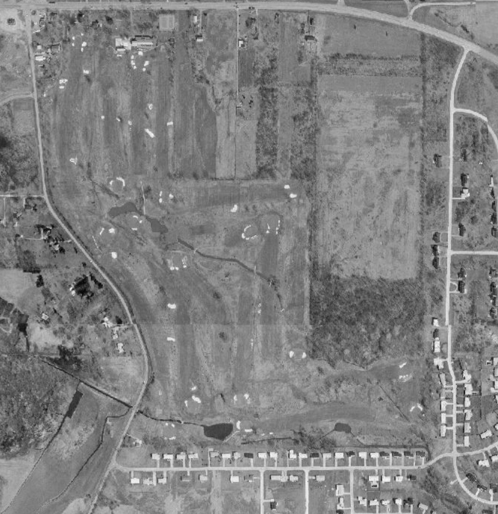
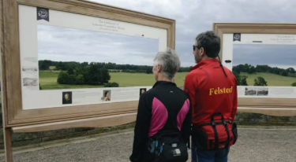
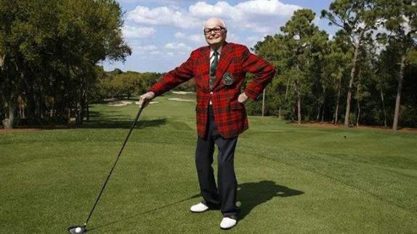
GOAL
Integrate Fairlawn character into the site
Integrate the region and site’s history– glaciers, golf, natural resources
Regionally significant and distinct passive recreation
Strengthen regional trail & waterway connections
Add ecotourism opportunities
LANDFORM AMENITIES
1970 aerial
DESIGN

Slide 26


GOAL
Integrate Fairlawn character into the site
Integrate the region and site’s history– glaciers, golf, natural resources
Regionally significant and distinct passive recreation
Strengthen regional trail & waterway connections
Add ecotourism opportunities
LANDFORM AMENITIES
Future connections to CVNP & Ohio Towpath
Future connections to the Great American Trail
DESIGN

Slide 27





GOAL
Integrate Fairlawn character into the site
Integrate the region and site’s history– glaciers, golf, natural resources
Regionally significant and distinct passive recreation
Strengthen regional trail & waterway connections
Add ecotourism opportunities
LANDFORM AMENITIES
Multiple types of trail surfaces
Loop trails & sinuosity – 3 miles of new trails
Overlooks, bridges & boardwalks to improve water access
Chip-seal
Concrete & Gravel
Improved existing bridge
DESIGN
Boardwalks
Pedestrian bridges

Slide 28


GOAL
Integrate Fairlawn character into the site
Integrate the region and site’s history– glaciers, golf, natural resources
Regionally significant and distinct passive recreation
Strengthen regional trail & waterway connections
Add ecotourism opportunities
LANDFORM AMENITIES
Opportunities for stream data collection
Bird blinds/wildlife viewing
Integration with revitalized Bicentennial Park
Mound Overlook
DESIGN

Slide 29




GOAL
Integrate Fairlawn character into the site
Integrate the region and site’s history– glaciers, golf, natural resources
Regionally significant and distinct passive recreation
Strengthen regional trail & waterway connections
Add ecotourism opportunities
LANDFORM AMENITIES
Natural Sciences and Technologies
DESIGN

Slide 30

Bicentennial Integration
PROJECT GOALS
  Flood Control
  Aquatic Enhancements
  Vegetative Improvements
  Landform Amenities
Notes:
Spruce up Bicentennial

Slide 31






Slide 32







Slide 33



Slide 34


Slide 35

| Funding & Financing
Opinion of Probable Construction Cost $6.8 million
Ohio EPA 319 Grant $302,475
WRRSP Grant $1,241,897
H2Ohio Grant $913,804
State Cap Grant $380,000
Clean Ohio TBD

Slide 36







SCHEDULE
Open bids on Oct 2nd
Preconstruction November 12 and 13th
Construction Start December 2025
Construction Completion December 2027

